Slide 1
Reasoning Uncertainty

Slide 2
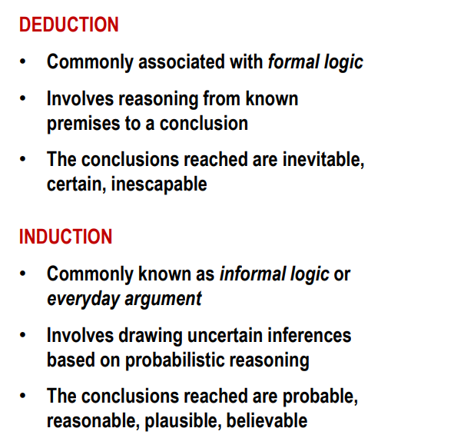
Deduction vs. Induction

Slide 3

Reasoning under Uncertainty
Reasoning under uncertainty is central to creating machines that exhibit intelligent behavior, one of the most-studied problems in artificial intelligence (AI).
Classical FOL cannot handle uncertainty
Toothache can be caused in many other cases and we may include all other cases.
Cavity does not always cause toothache.

Slide 4
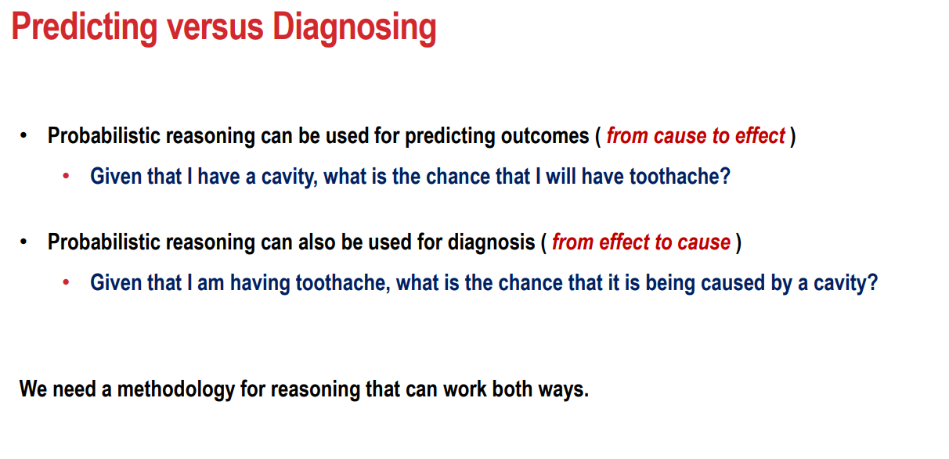
Reasoning under uncertainty classified into two paradigms:
Bayesian and non-Bayesian.

Slide 5
Probability Axioms
0 ≤ p(A) ≤ 1
p(true) = 1, p(false) = 0
Independent events A and B: p(A ∩ B) = p(A) p(B).
The events E₁, E₂, ..., E_{n} in a sample space S, are independent if
p(E_{i1} ∩ ... ∩ E_{ik}) = p(E_{i1}) ...p(E_{ik})
for each subset {i₁, ...,i_{k}) ⊆{1, ..., n},1≤ k ≤ n, n ≥ 1.
Events A and B are mutually exclusive: p(A ∪ B) = p(A) + p(B)
When A and B are not mutually exclusive:
p(A ∪ B) = p(A) + p(B) - p(A ∩ B)
This is also called Law of Addition.

Slide 6
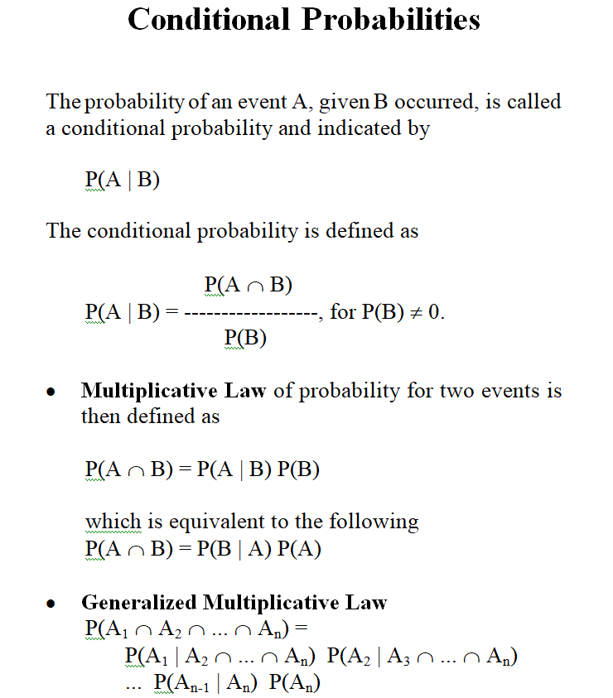

Slide 7
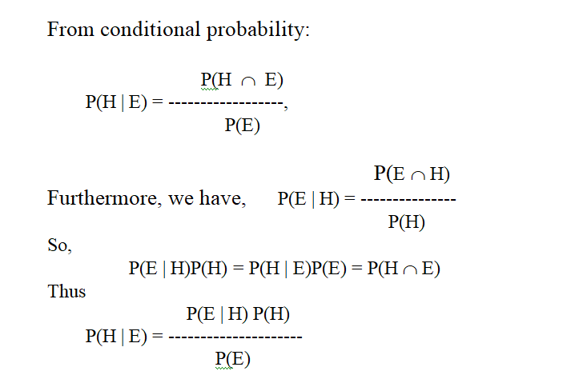
Bayes’ Theorem
In real-life practice, the probability P(H | E) cannot always be found in the literature or obtained from statistical analysis. The conditional probabilities P(E | H)
however often are easier to obtain from the probabilities P(E), P(H) and P(E | H);

Slide 8
Bayesian Approach
Bayesian approaches represent knowledge about a set of state variables as probabilities.
State variables can be either discrete or continuous.
Variables are initialized a prior (starting estimate) and then updated using Bayes’ rule when new evidence is received.
In Bayesian model assumes that all variables are uncorrelated.
Rather than reasoning about the truth or falsity of a proposition, reason about the belief that a proposition or event is true or false
For each primitive proposition or event, attach a degree of belief to the sentence.
Use probability theory as a formal means of dealing with degrees of belief.

Slide 9
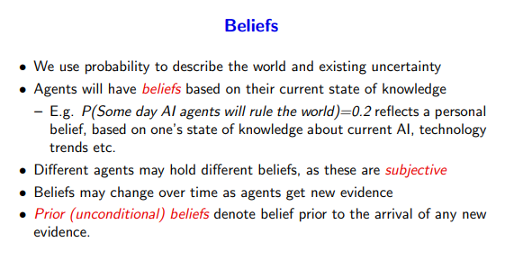
Bayesian network is based on Joint probability distribution and conditional probability.

Slide 10
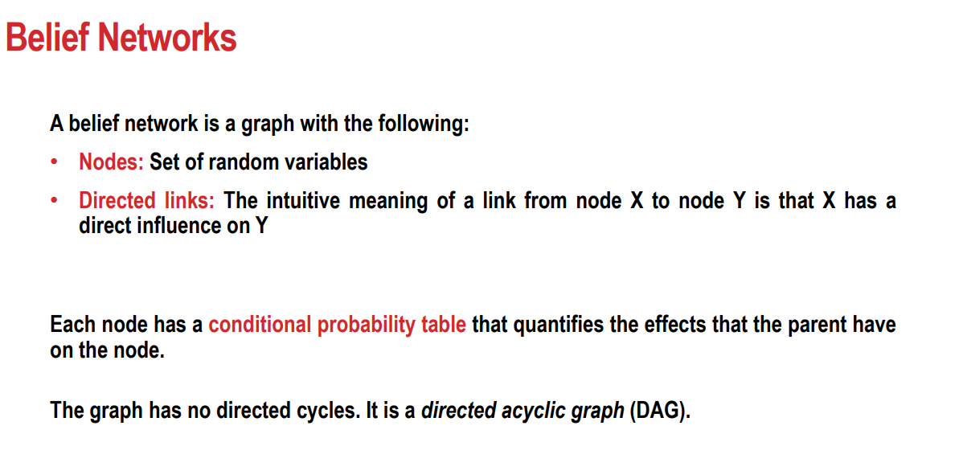
Bayesian belief network dealing with probabilistic events and solve problem
which has uncertainty.
Belief nets use an acyclic directed graph to represent joint probability distribution

Slide 11
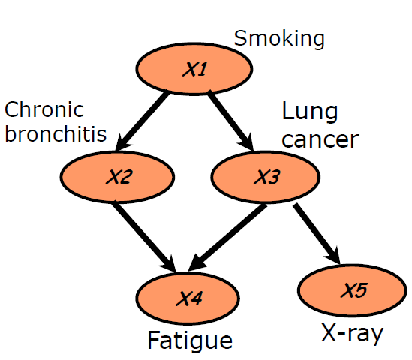
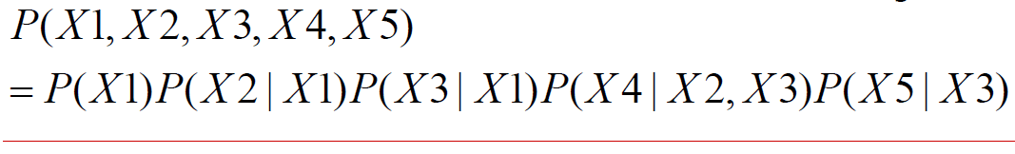

Slide 12


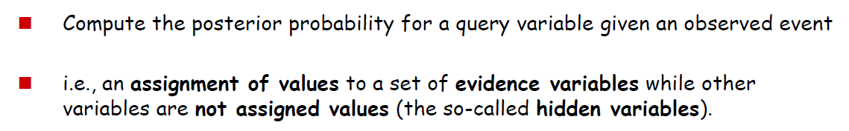
Joint probability distribution
If we have variables x₁, x₂, x₃,....., x_{n}, then Joint probability distribution.
p[x₁, x₂, x₃,....., x_{n}]
= p[x₁| x₂, x₃,....., x_{n}]p[x₂, x₃,....., x_{n}]
= p[x₁| x₂, x₃,....., x_{n}]p[x₂|x₃,....., x_{n}]....p[x_{n-1}|x_{n}]p[x_{n}].

Slide 13
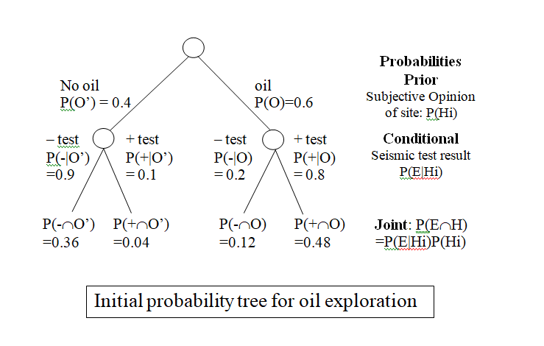
Example: Suppose the prospector believes that there is a better than 50-50 chance of finding oil, and assumes P(O) = 0.6 and P(O’) = 0.4
Using the seismic survey technique, we obtain the following conditional probabilities, where + means a positive outcome and - is a negative outcome
P(+ | O) = 0.8 P(- | O) = 0.2 (false -)
P(+ | O’) = 0.1 (false +) P(- | O’) = 0.9
Using the prior and conditional probabilities,
we can construct the initial
probability tree.

Slide 14
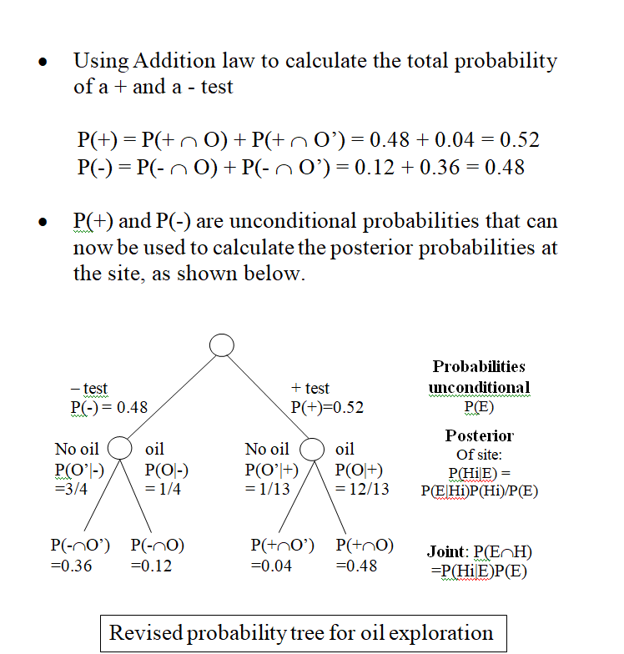

Slide 15
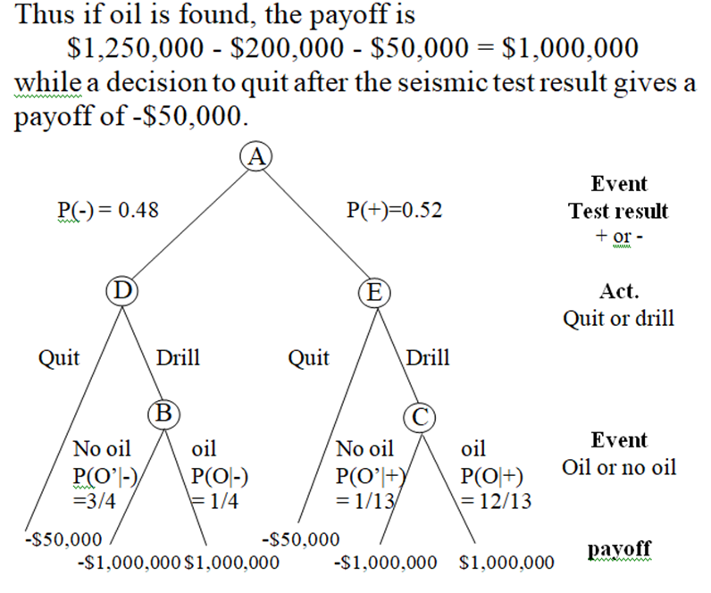
The assumed amounts are:
Oil lease, if successful: $1,250,000
Drilling expense: -$200,000
Seismic survey: -$50,000
In order for the prospector to make the best decision, the expected payoff
Is calculated at event node A.
To compute the expected payoff at A, work backward from the
leaves. This process is called backward induction.

Slide 16
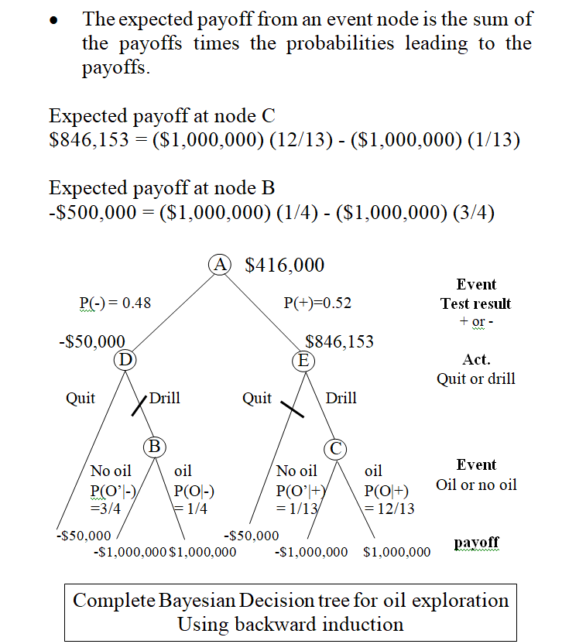
The decision tree shows the optimal strategy for the prospector.
If the seismic test is positive, the site should be drilled, otherwise,
the site should be abandoned.
The decision tree is an example of hypothetical reasoning or “what if” type of situations.
By exploring alternate paths of action, we can prune paths that do not lead to optimal payoffs.

Slide 17
Bayes’ rule and knowledge-based systems
Knowledge-base IF-THEN format:
IF X is true THEN Y can be concluded with probability p
If we observe that X is true, then we can conclude that Y exist with the specified probability.
For example
IF the patient has a cold
THEN the patient will sneeze (0.75)
But what if we reason abductively and observe Y (i.e., the patient sneezes) while knowing nothing about X (i.e., the patient has a cold)?
What can we conclude about it?
Bayes’ Theorem describes how we can derive a probability for X.

Slide 18
Y (denotes some piece of evidence (typically referred to as E) and X denotes some hypothesis (H) given
P(E | H) P(H)
P(H | E) = -------------------
P(E)
or
P(E | H) P(H)
P(H | E) = -----------------------------------------
P(E | H)P(H) + P(E | H’)P(H’)
The probability of sneezing is the sum of the conditional probability that he sneezes when with a cold and the conditional probability without cold.

Slide 19
P(H) = P(has a cold) = 0.2
P(E | H) =P(observed sneezing | has a cold) = 0.75
P(E | H’) = P(was observed sneezing | does not have a cold) = 0.2
Then
P(E) = P(observed sneezing) = (0.75)(0.2) + (0.2)(0.8) = 0.31
and
P(H | E) =P(has a cold | observed sneezing) = (0.75)(0.2)
---------------
(0.31)
probability of having a cold given that he sneezes = 0.48387
P(E’ | H)P(H)
P(H | E’) = -------------------
P(E’)
(1-0.75) (0.2)
= -------------------
(1 - 0.31)
= 0.07246 probability of having a cold would be if was not sneezing:

Slide 20
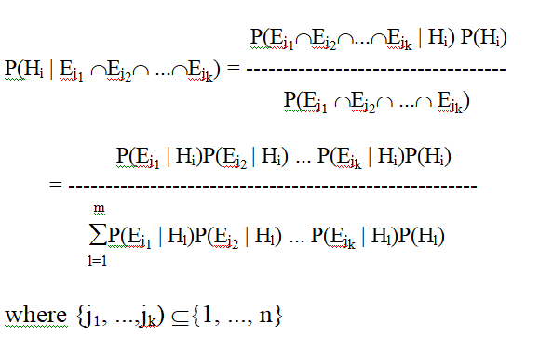
Propagation of Belief
We have only considered when each piece of evidence affects only one hypothesis.
To deal with real-world problems, consider “m” hypotheses H₁, H₂, ... H_{m} and “n” pieces of evidence E₁, ..., E_{n}.
This probability is called the posterior
probability of hypothesis H_{i} from observing
evidence E_{j1}, E_{j2}, ..., E_{jk}.

Slide 21

Assumptions:
The hypotheses H₁, ..., H_{m}, m ≥ 1, are mutually exclusive.
Furthermore, the hypotheses H₁, ..., H_{m} are collectively exhaustive.
The pieces of evidence E₁, ..., E_{n}, n ≥ 1, are conditionally independent given any hypothesis H_{i}, 1 ≤ i ≤ m .
The events E₁, E₂, ..., E_{n}, are conditionally independent given an event H if
Often causes great difficulties for probabilistic based methods.

Slide 22
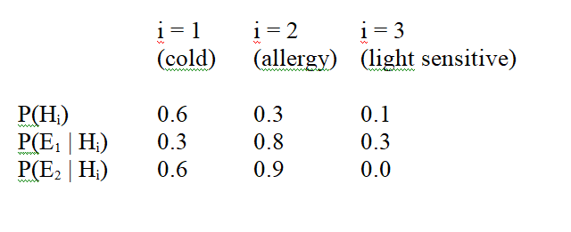
Consider three mutually exclusive and exhaustive hypotheses with values.
H₁, the patient, has a cold;
H₂, the patient has an allergy; and
H₃, the patient has a sensitivity to light
With prior probabilities, p(H_{i})’s, and two conditionally independent pieces of evidence
E₁, the patient sneezes and E₂, the patient has coughs

Slide 23
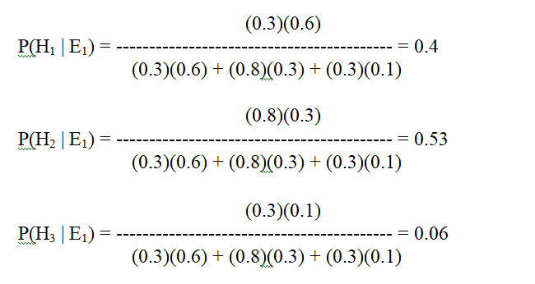
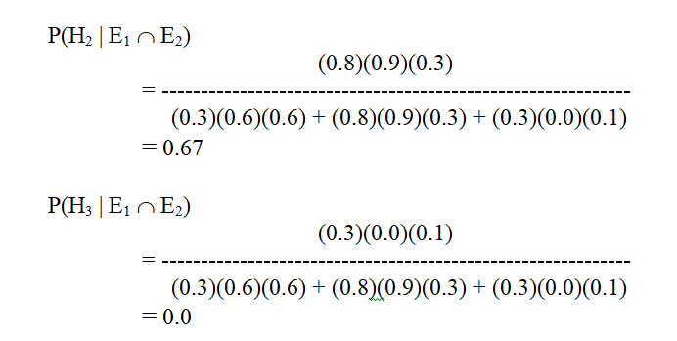
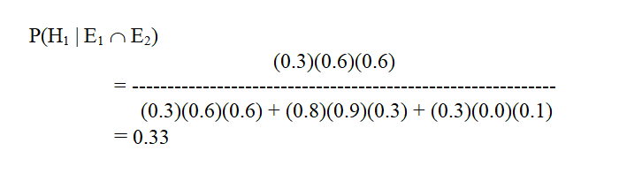
If we observe evidence E₁ (e.g., the patient sneezes), we can compute posterior probabilities for the hypotheses:
The belief in hypotheses H₁ and H₃
have both decreased while the belief
in hypothesis H₂ has increased after
observing E₁.
If E₂ (e.g., the patient coughs) is now observed, new posterior probabilities

Slide 24
Burglar Alarm at home
Harry installed a new burglar alarm at his home to detect burglary.
The alarm reliably responds at detecting a burglary but also responds for minor earthquakes.
Harry has two neighbors John and Marya, who have taken a responsibility to inform Harry at work when they hear the alarm.
John always calls Harry when he hears the alarm, but sometimes he got confused with the phone ringing and calls at that time too.
On the other hand, Mary likes to listen to high music, so sometimes she misses to hear the alarm.
We would like to compute the probability of Burglary Alarm.
Problem:
Calculate the probability that alarm has sounded, but there is neither a burglary, nor an earthquake occurred, and John and Mary both called the Harry.
Events occurring in this network:
Burglary (B)
Earthquake(E)
Alarm(A)
John Calls(J)
Mary calls(M)

Slide 25
write the events of problem statement in terms of probability:
p[J, M, A, B, E],
Write probability statement using joint probability distribution:
p[J, M, A, B, E]= p[J | M, A, B, E]. p[M, A, B, E]
= p[J | M, A, B, E]. p[M | A, B, E]. p[A, B, E]
= .
= .
= .
p(B= True) = 0.001, probability of burglary.
p(B= False)= 0.999, probability of no burglary.
p(E= True)= 0.002, probability of a minor earthquake
p(E= False)= 0.998, probability that an earthquake not occurred.

Slide 26
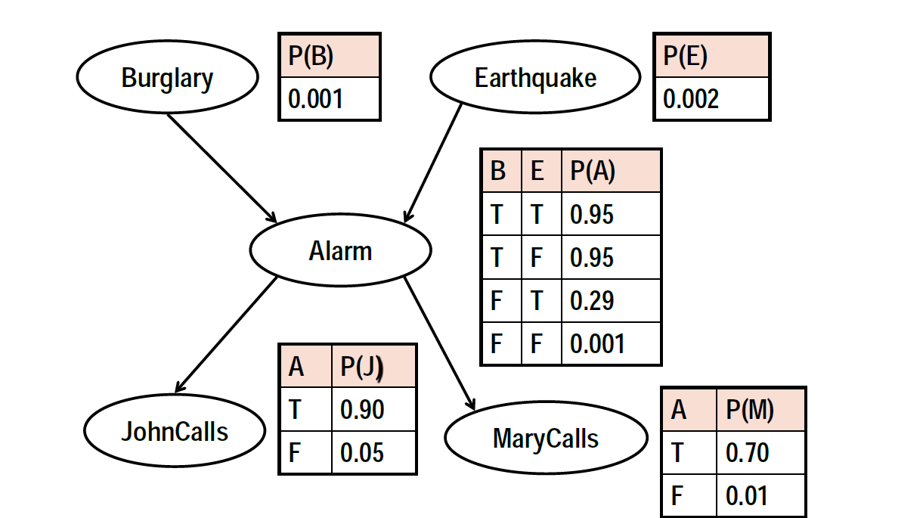

Slide 27
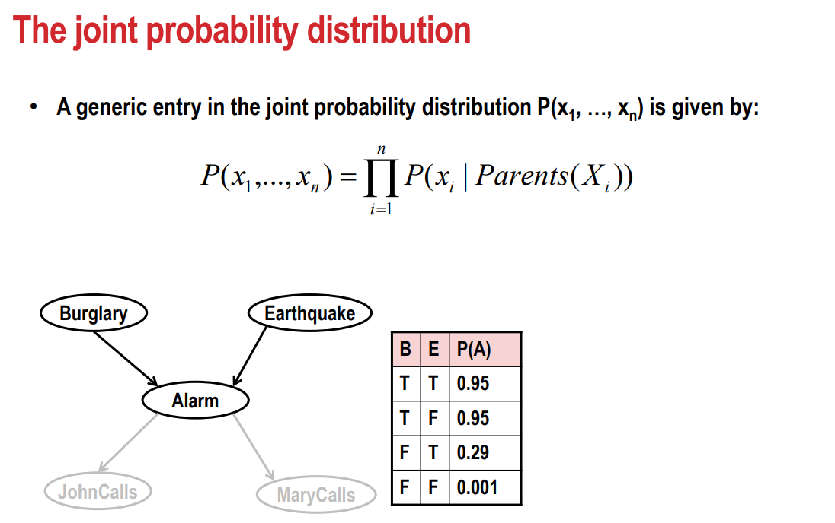

Slide 28
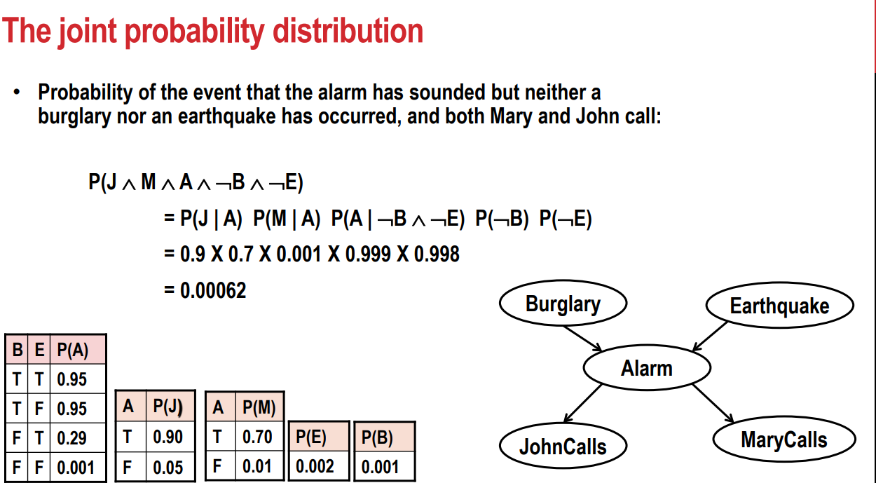

Slide 29
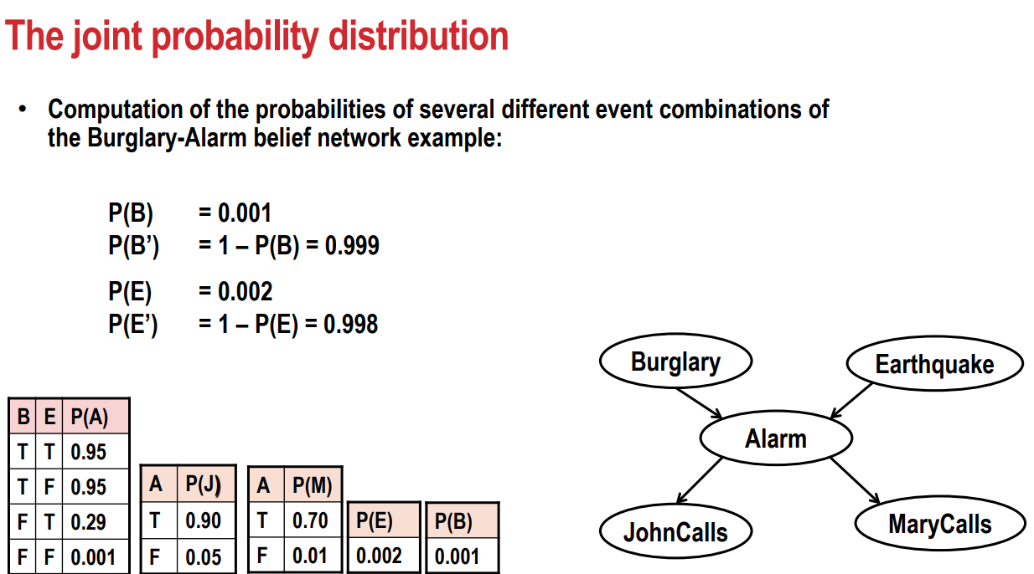

Slide 30
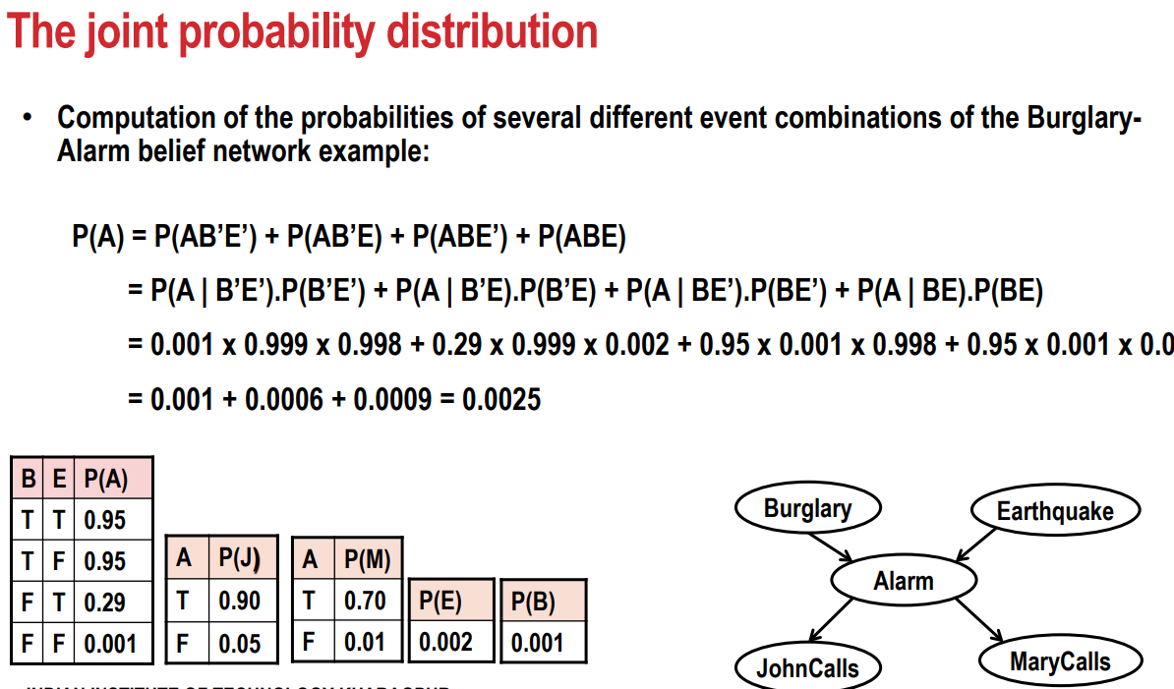

Slide 31
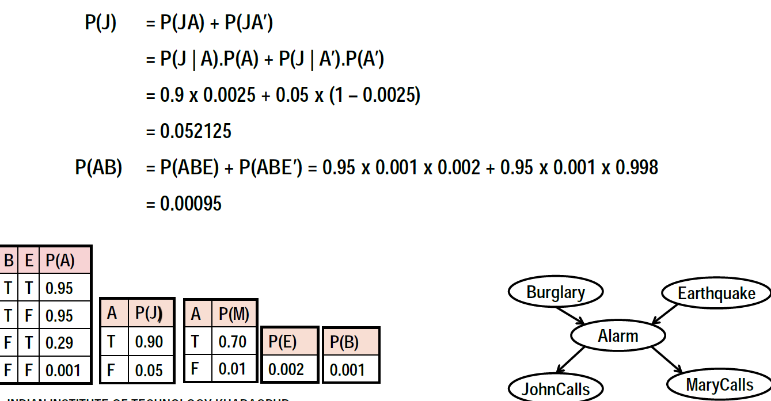
The joint probability distribution: Find P(J)

Slide 32
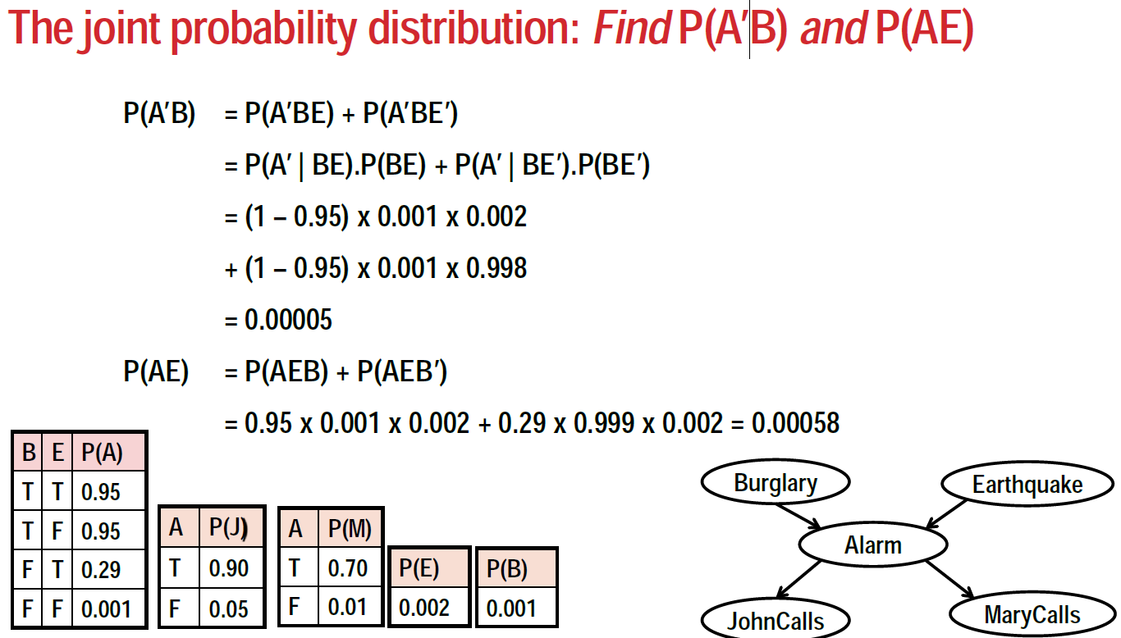

Slide 33
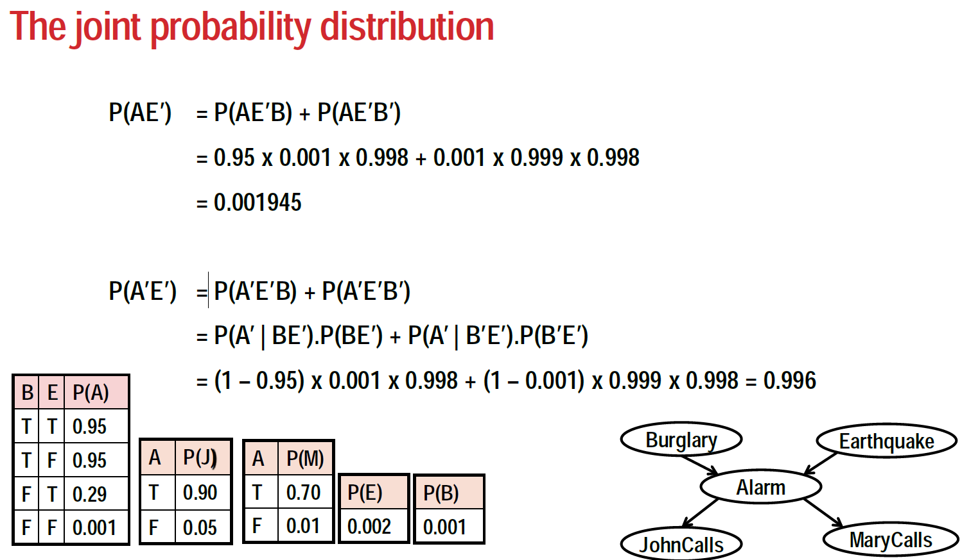

Slide 34
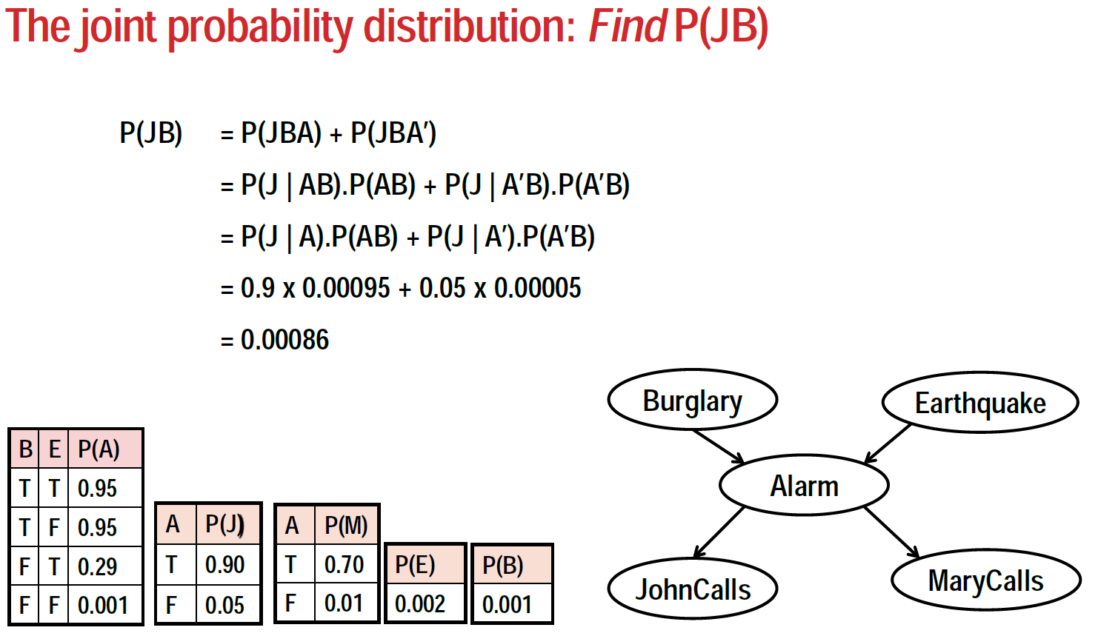

Slide 35
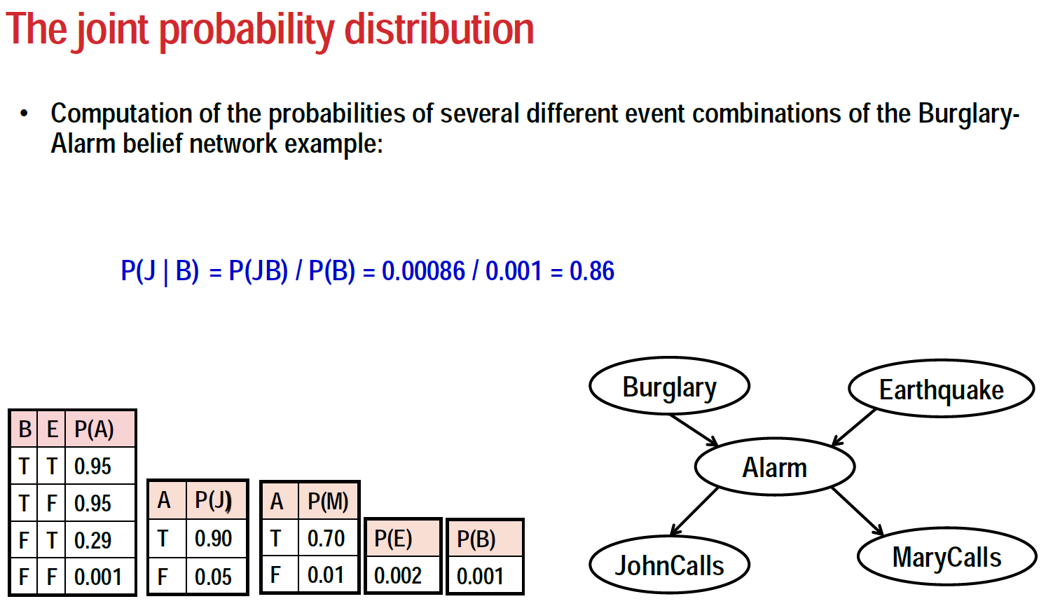

Slide 36
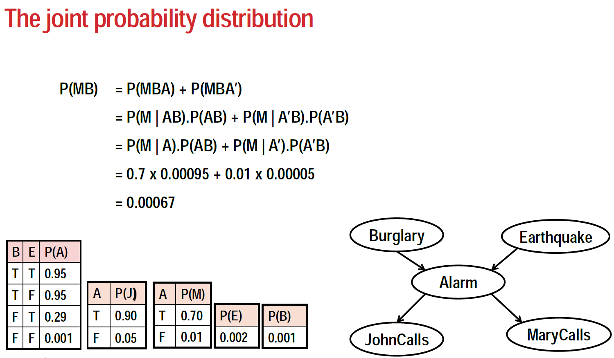

Slide 37
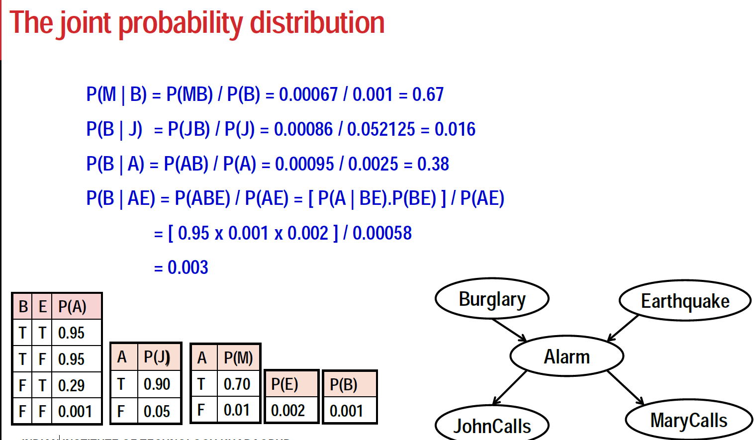

Slide 38
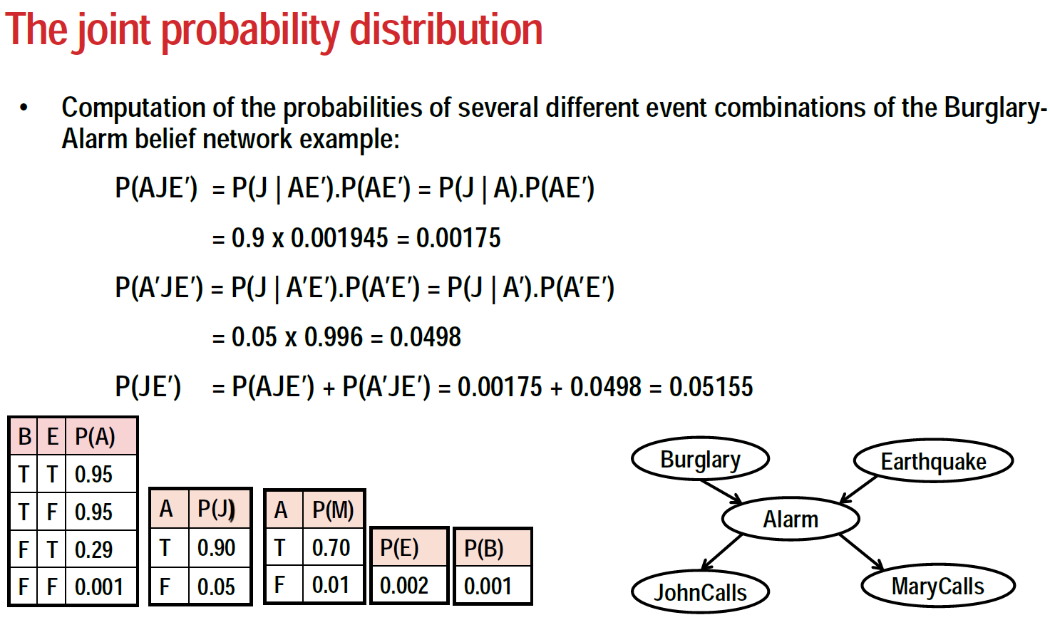

Slide 39
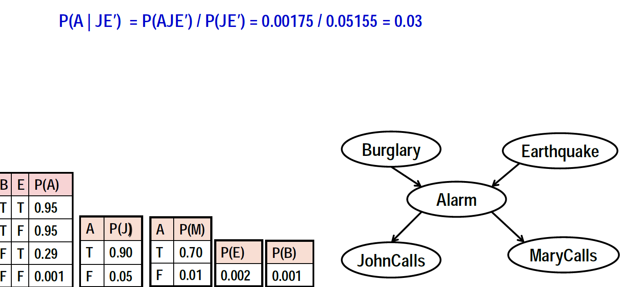

Slide 40
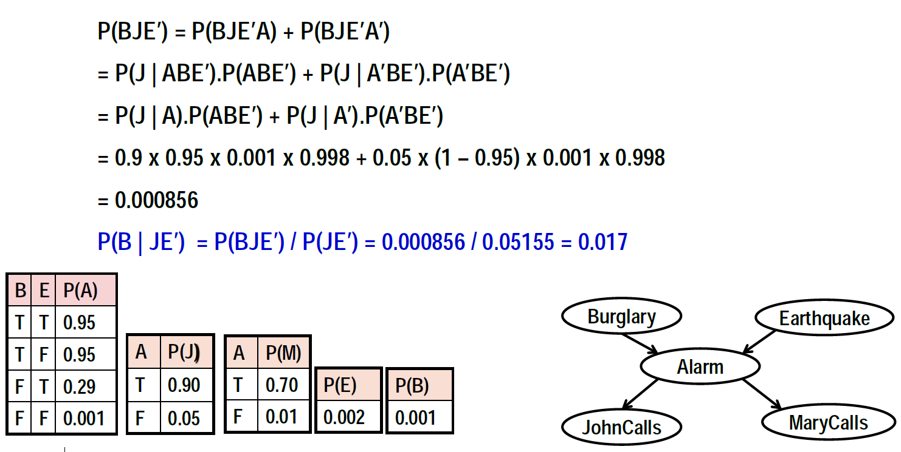

Slide 41
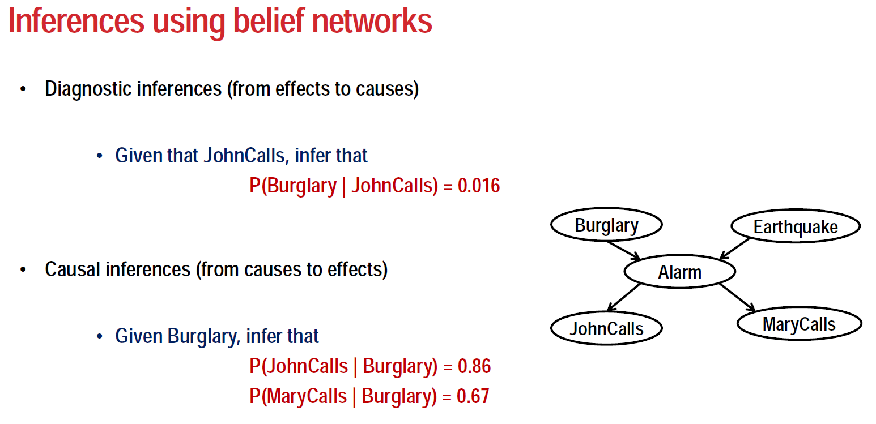

Slide 42
Advantages and disadvantages of Bayesian methods
Most significant is their sound theoretical foundation in probability theory. Thus, they are currently the most mature of all of the uncertainty reasoning methods.
Require a significant amount of sample sizes so that the probabilities obtained are accurate and sufficient data to construct a knowledge base.
Furthermore, human experts are normally uncertain, whether the values consistent and comprehensive?

Slide 43
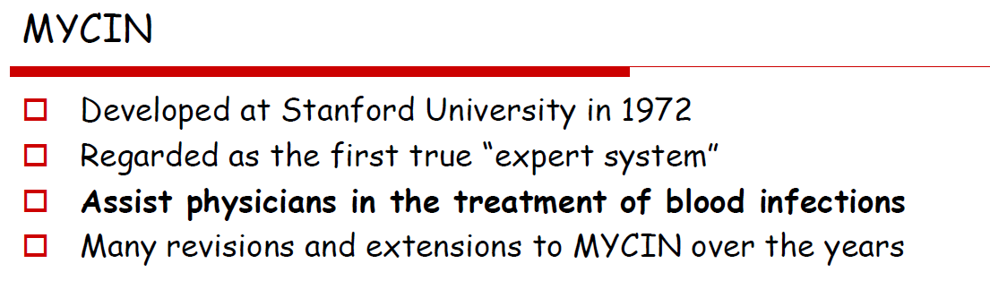

Slide 44
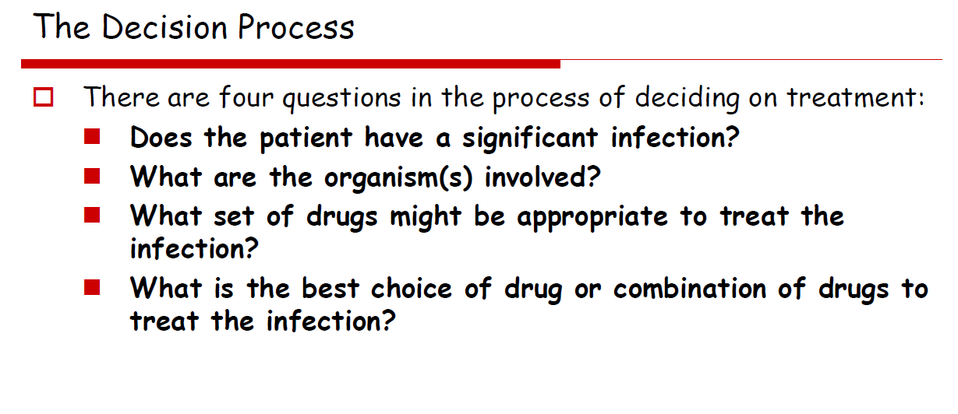
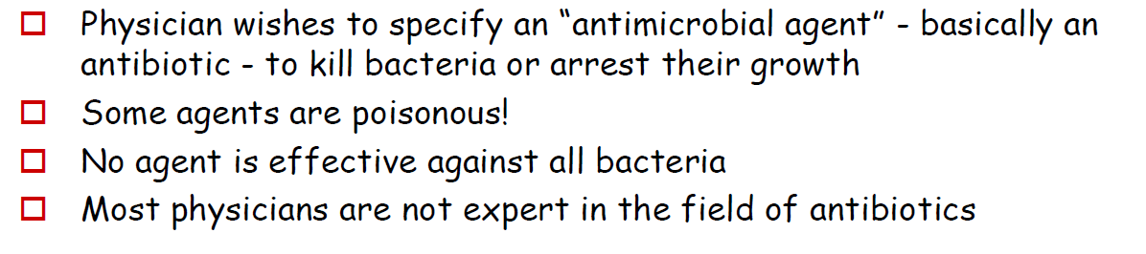

Slide 45
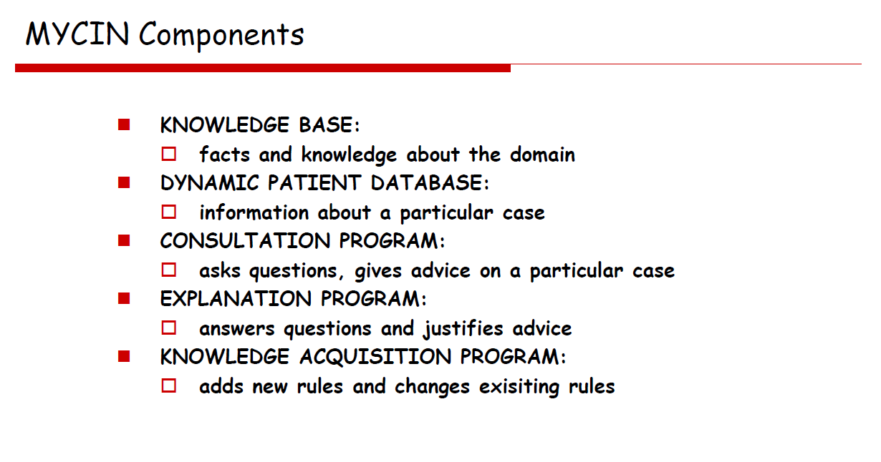
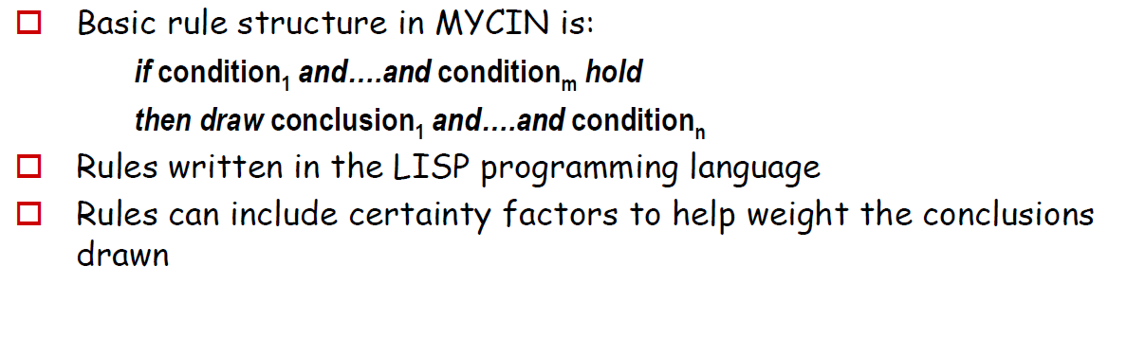

Slide 46
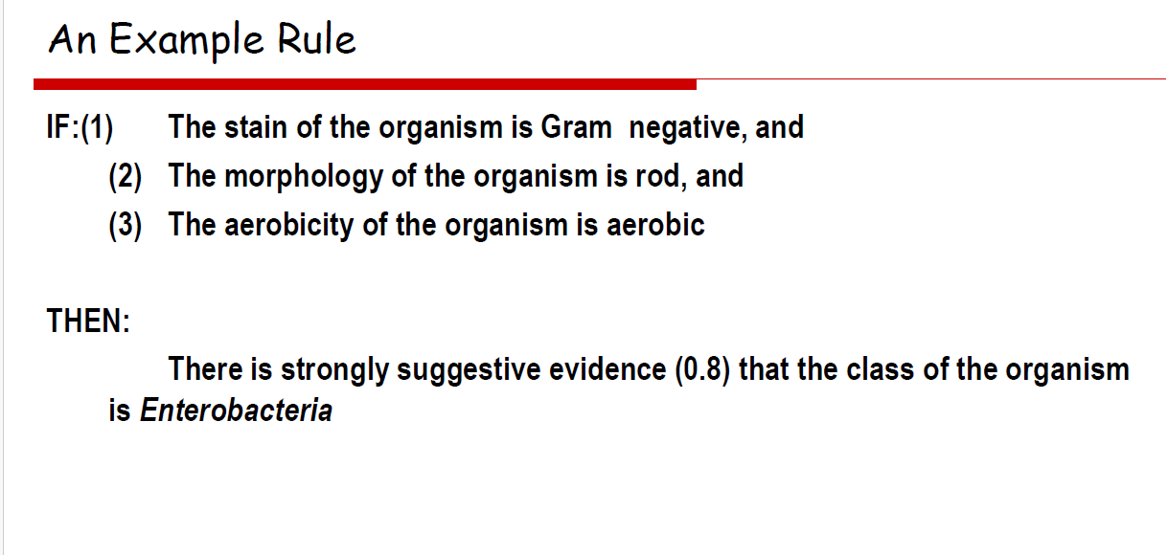
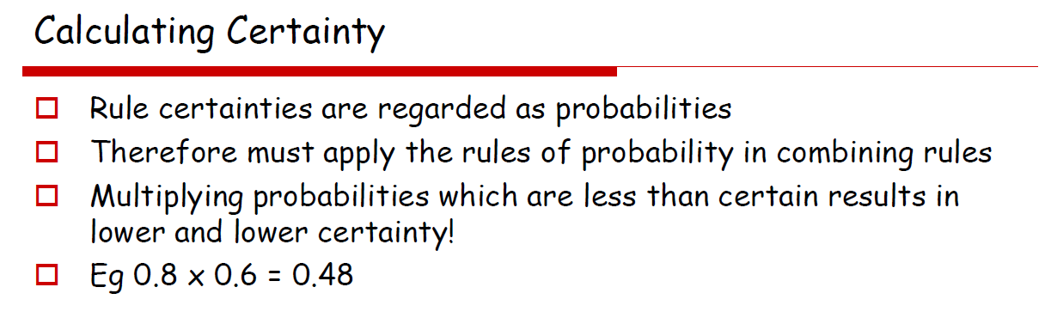

Slide 47
Utility Theory
Utility theory in AI provides a mathematical framework for understanding how AI systems make choices among different options based on their perceived value or utility.
Utility theory offers a framework for making decisions in situations of ambiguity by putting utilities(values) on several possible results.
It is very useful in optimising and modeling decision-making processes by considering uncertain and probabilistic outcomes in different situations.
It allows one to assign subjective values or preferences to different outcomes and helps make optimal choices based on these values.
Utility theory is widely used in various AI applications such as game theory, economics, robotics, and recommendation systems, among others.

Slide 48
In a recommendation system, the utility could describe the level of user satisfaction with a particular recommendation.
In a robotics application, a utility could represent the cost or risk of different actions.
The AI system can then choose the action with the highest expected utility.
Basic notation commonly used in utility theory:
Let x represents an outcome or option
Let U(x) denote the utility function, which maps x to its utility value
Let p(x) denote the probability of outcome x occurring.
Let E[U(x)] denote the expected utility of outcome x, which is the sum of the utility values of all possible outcomes weighted by their respective probabilities.
E[U(x)] = ∑_{i} p(x_{i}) . U(x_{i})

Slide 49
Maximum Expected Utility
MEU is a decision-making principle that suggests choosing the option that maximizes the expected utility.
In other words, an AI system should select the option that is expected to yield the highest utility value, taking into account the probabilities of different outcomes.
Utility theory in AI is based on a set of axioms or principles that define the properties of a rational utility function.
Key utility theory axioms:
Orderability
A rational utility function should allow for comparing different outcomes based on their utility values. In other words, if U(x)>U(y), then outcome x is preferred to outcome y.

Slide 50
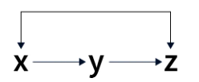
Transitivity
If outcome x is preferred to outcome y, and outcome y is preferred to outcome z, then outcome x should be preferred to outcome z.
This axiom ensures that the preferences modeled by the utility function are consistent and do not lead to contradictions.
Continuity
Small changes in the probabilities of outcomes should result in small changes in the expected utility.
This axiom ensures that the utility function is smooth and well-behaved and that small changes in probabilities do not result in abrupt changes in decision-making.

Slide 51
Substitutability
If two outcomes, x and y, are equally preferred, then we should equally prefer any combination of x and y.
This axiom allows for substituting equally preferred outcomes without affecting the decision-making process.
Monotonicity
If the probability of an outcome increases, its expected utility should also increase.
This axiom ensures that an increase in the likelihood of an outcome increases its perceived value or utility.
Decomposability
The utility function should be able to represent preferences over multiple attributes or features of an outcome in a decomposable manner.
This allows for modeling complex decision problems with multiple dimensions or criteria.

Slide 52
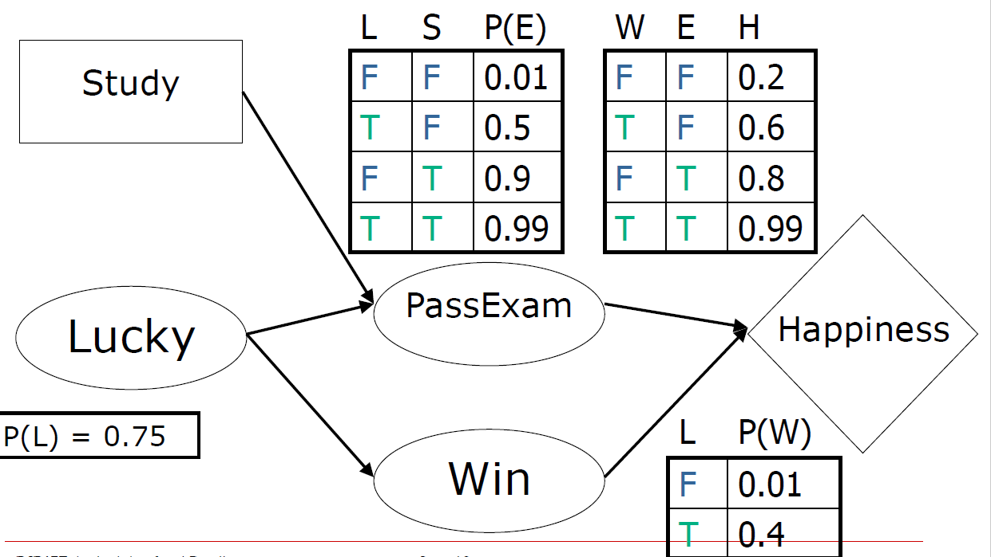
Assignment

